Slide 1
Chapter 4:
Logical Database Design and the Relational Model
Modern Database Management
10^{h} Edition
Jeffrey A. Hoffer, V. Ramesh,
Heikki Topi
© 2011 Pearson Education, Inc. Publishing as Prentice Hall

Slide 2

Key Fields
Keys are special fields that serve two main purposes:
  Primary keys are unique identifiers of the relation in question. Examples include employee numbers, social security numbers, etc. This is how we can guarantee that all rows are unique.
  Foreign keys are identifiers that enable a dependent relation (on the many side of a relationship) to refer to its parent relation (on the one side of the relationship).
Keys can be simple (a single field) or composite (more than one field).
Keys usually are used as indexes to speed up the response to user queries (more on this in Chapter 5).

Slide 3
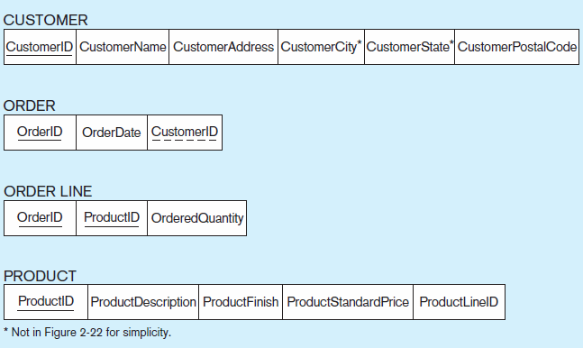
Figure 4-3 Schema for four relations (Pine Valley Furniture Company)
Primary Key
Foreign Key (implements 1:N relationship between customer and order)
Combined, these are a composite primary key (uniquely identifies the order line)…individually they are foreign keys (implement M:N relationship between order and product)

Slide 4
Integrity Constraints
Domain Constraints
  Allowable values for an attribute. See Table 4-1
Entity Integrity
  No primary key attribute may be null. All primary key fields MUST have data
Action Assertions
  Business rules. Recall from Chapter 4

Slide 5
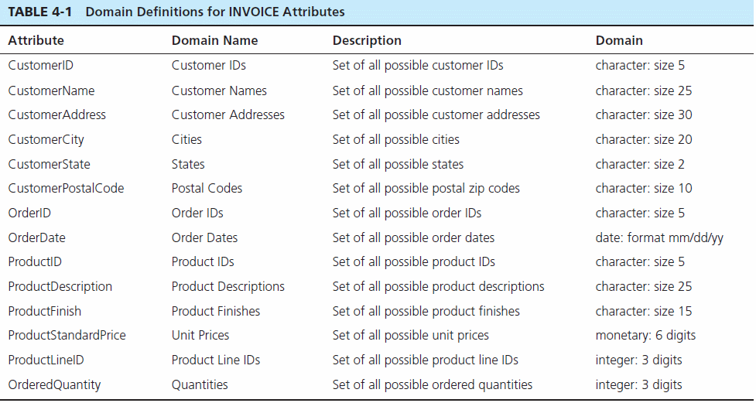
Domain definitions enforce domain integrity constraints
Notes:
Domain constraints implemented via data types

Slide 6
Integrity Constraints
Referential Integrity–rule states that any foreign key value (on the relation of the many side) MUST match a primary key value in the relation of the one side. (Or the foreign key can be null)
  For example: Delete Rules
    Restrict–don’t allow delete of “parent” side if related rows exist in “dependent” side
    Cascade–automatically delete “dependent” side rows that correspond with the “parent” side row to be deleted
    Set-to-Null–set the foreign key in the dependent side to null if deleting from the parent side → not allowed for weak entities

Slide 7
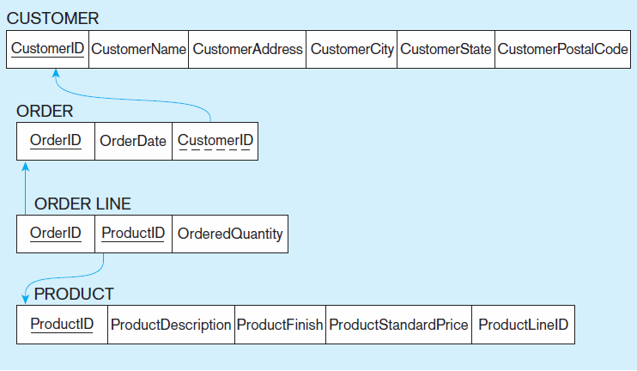
Figure 4-5
Referential integrity constraints (Pine Valley Furniture)
Referential integrity constraints are drawn via arrows from dependent to parent table

Slide 8
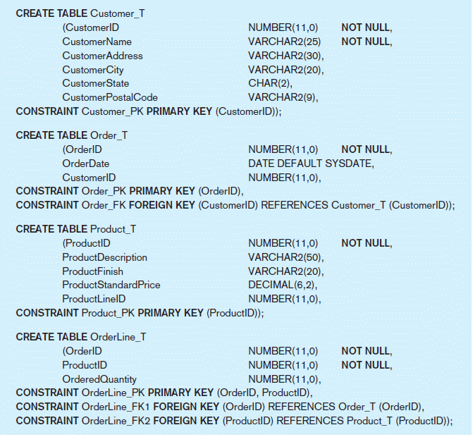
Figure 4-6 SQL table definitions
Referential integrity constraints are implemented with foreign key to primary key references

Slide 9
Transforming EER Diagrams into Relations
Mapping Regular Entities to Relations
  Simple attributes: E-R attributes map directly onto the relation
  Composite attributes: Use only their simple, component attributes
  Multivalued Attribute: Becomes a separate relation with a foreign key taken from the superior entity

Slide 10

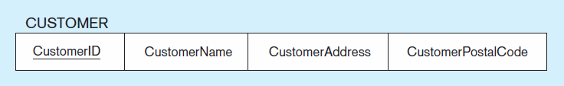
Figure 4-8 Mapping a regular entity
(a) CUSTOMER entity type with simple attributes
(b) CUSTOMER relation
Notes:
All simple ( entity, attribuite)

Slide 11
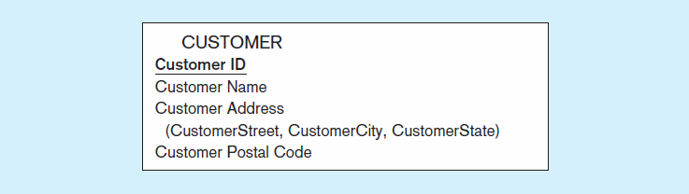

Figure 4-9 Mapping a composite attribute
(a) CUSTOMER entity type with composite attribute
(b) CUSTOMER relation with address detail
Notes:
Composite attribute -> break the attribute into its individual part

Slide 12

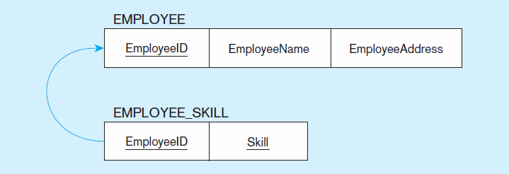
Figure 4-10 Mapping an entity with a multivalued attribute
(a)
Multivalued attribute becomes a separate relation with foreign key
(b)
One–to–many relationship between original entity and new relation
Notes:
Multi-value
It becomes a separate relation

Slide 13
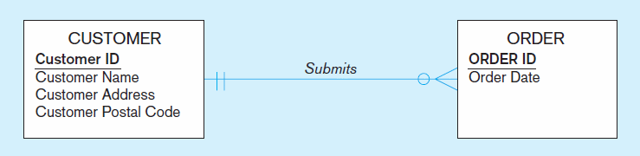
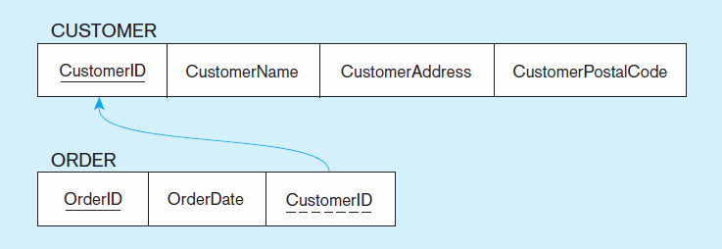
Figure 4-12 Example of mapping a 1:M relationship
a) Relationship between customers and orders
Note the mandatory one
b) Mapping the relationship
Again, no null value in the foreign key…this is because of the mandatory minimum cardinality
Foreign key
Notes:
One to many

Slide 14
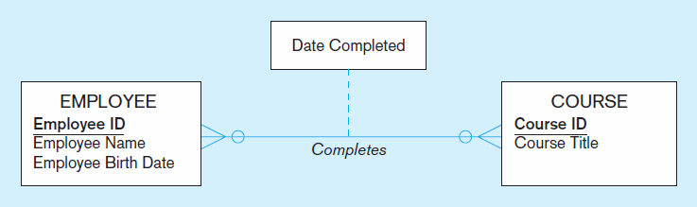
Figure 4-13 Example of mapping an M:N relationship
a) Completes relationship (M:N)
The Completes relationship will need to become a separate relation
Notes:
Many to many relashionships

Slide 15
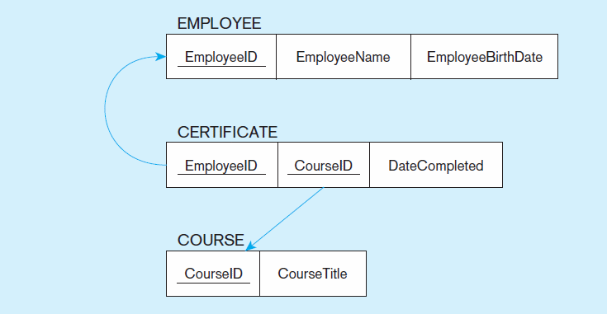
Figure 4-13 Example of mapping an M:N relationship (cont.)
b) Three resulting relations
Composite primary key
Foreign key
New intersection relation
Foreign key

Slide 16
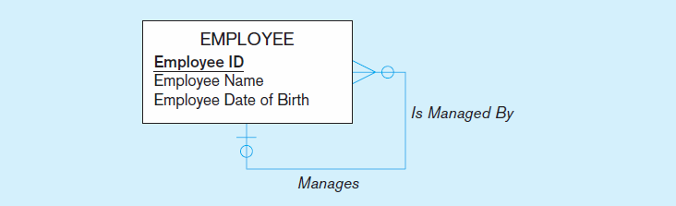
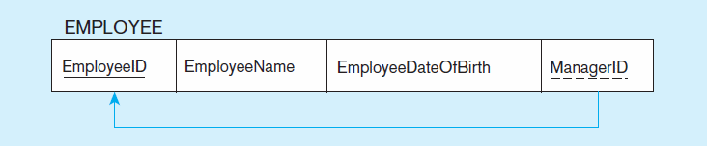
Figure 4-17 Mapping a unary 1:N relationship
(a) EMPLOYEE entity with unary relationship
(b) EMPLOYEE relation with recursive foreign key

Slide 17
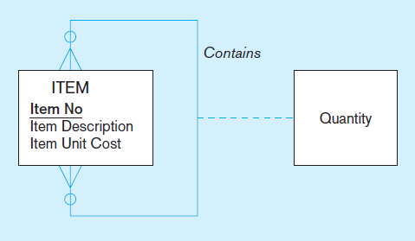
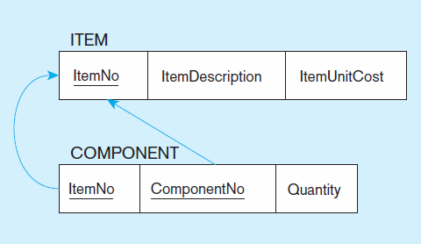
Figure 4-18 Mapping a unary M:N relationship
(a) Bill-of-materials relationships (M:N)
(b) ITEM and COMPONENT relations
Notes:
Unary many to many

Slide 18
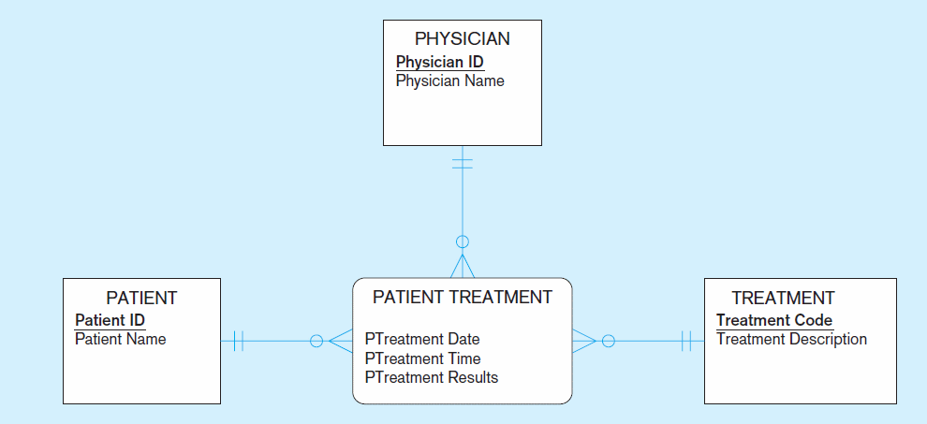
Figure 4-19 Mapping a ternary relationship
a) PATIENT TREATMENT Ternary relationship with associative entity
Notes:
Ternary relationship with associative entity

Slide 19
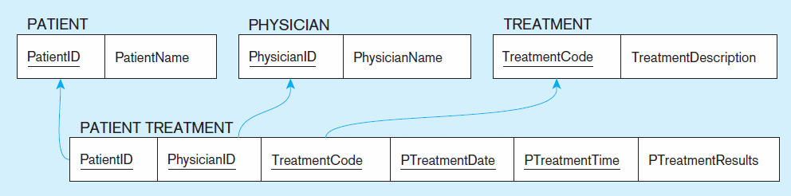
Figure 4-19 Mapping a ternary relationship (cont.)
b) Mapping the ternary relationship PATIENT TREATMENT
Remember that the primary key MUST be unique
This is why treatment date and time are included in the composite primary key
But this makes a very cumbersome key…
It would be better to create a surrogate key like Treatment#

Slide 20
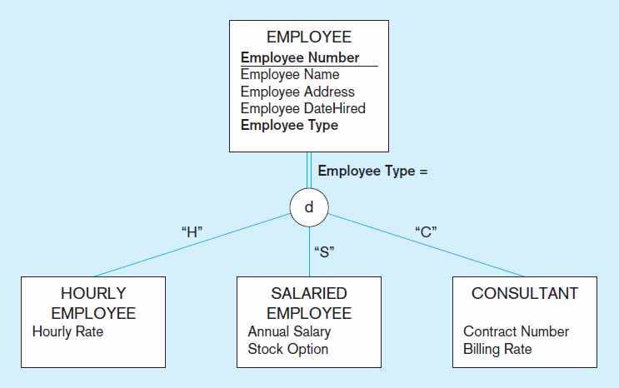
Figure 4-20 Supertype/subtype relationships

Slide 21
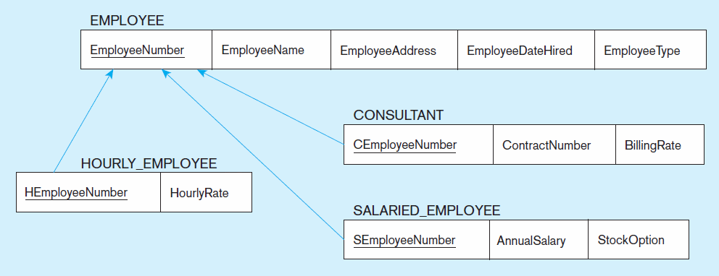
Figure 4-21
Mapping supertype/subtype relationships to relations
These are implemented as one-to-one relationships

